Slide 1

Java OOP and Data Structures with Introduction to Secure Coding Dr. Ziping Liu
Chapter 15 LinkedList

Slide 2
https://he.kendallhunt.com/product/java-oop-and-data-structures-introduction-secure-coding
Chapter 15 LinkedList

Slide 3

Chapter Outlines
Introduction to LinkedList
Simple implementation of a singly linked list using nodes
Iterable singly linked list implementation using nodes
Doubly linked list implementation using the List interface
The built-in LinkedList collection in Java

Slide 4
15.1 Introduction to LinkedList
A LinkedList is an explicitly ordered collection of items, where each item is stored in a node.
The first item is contained in the first node, which includes a pointer to the next node in the sequence.
Each node explicitly links to the next, creating a chain-like structure.
Key Operations of a LinkedList:
Insert
Remove
LinkedLists allow efficient insertions and deletions at any point in the list. However, there is no direct access to elements—referencing an element like x[i] is not possible.

Slide 5
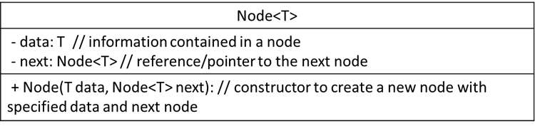
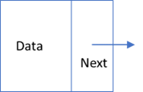
15.2 A Simple Singly Linked List Implementation Using Nodes
Definition of Node:
consists of two parts: a data field, which stores the information contained in the node, and a next field, which is a reference (or pointer) to another node. The next field allows nodes to be connected, forming a chain where one node links to another, and so on.

Slide 6
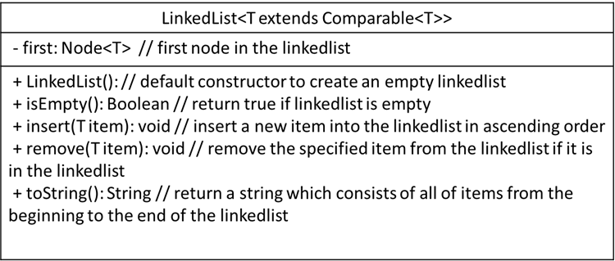
15.2 A Simple Singly Linked List Implementation Using Nodes
Definition of Singly LinkedList:
the linked structure can only be traversed in one direction—from the first node to the last.

Slide 7
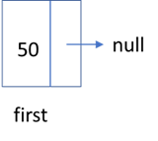
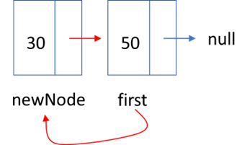
15.2.3 Implementation of Singly LinkedList
Figure 15.4 First Node is inserted
Figure 15.5 Insert at the beginning

Slide 8
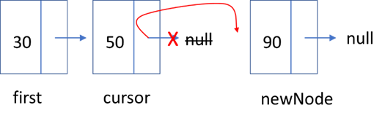
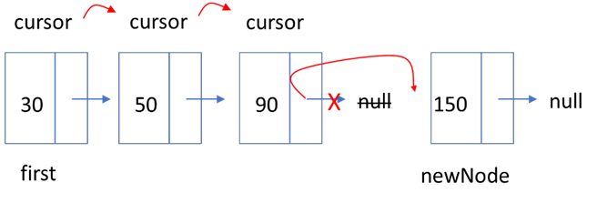
15.2.3 Implementation of Singly LinkedList
Figure 15.6 Insert at the back
Figure 15.7 Insert at the back

Slide 9
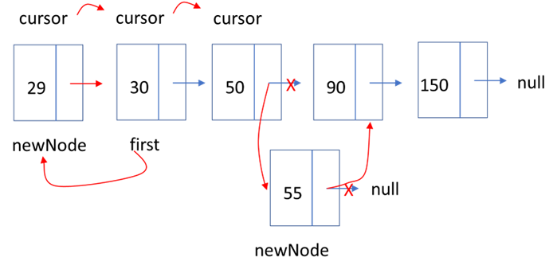
15.2.3 Implementation of Singly LinkedList
Figure 15.8 Insert in the middle

Slide 10
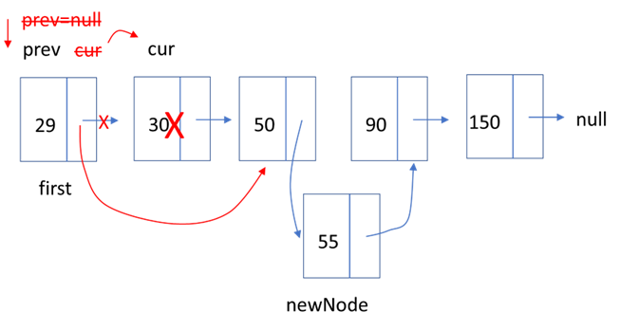
15.2.3 Implementation of Singly LinkedList
Figure 15.9 Node deleted in the middle

Slide 11
15.2 A Simple Singly Linked List Implementation Using Nodes
Core Concept: Pair-advancing in LinkedList
prev = cur; cur = cur.next;
Core Concept: loop for traversing the linked list node by node
for(Node cursor = first; cursor != null; cursor = cursor.next)

Slide 12
15.3 An Iterable Singly Linked List Implementation Using Nodes
Definition of Iterable Singly LinkedList:
the LinkedList class implements the Iterable interface, enabling both the for-each loop and iterator-based iteration.

Slide 13
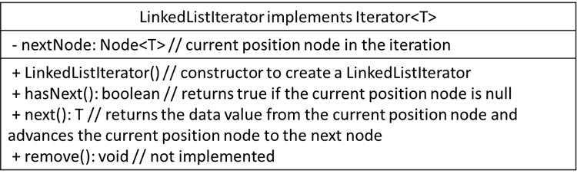
15.3 An Iterable Singly Linked List Implementation Using Nodes
Definition of LinkedListIterator:

Slide 14
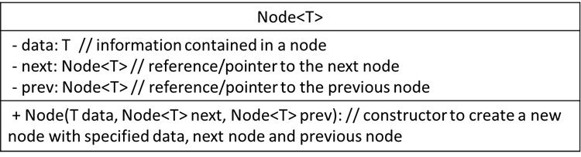
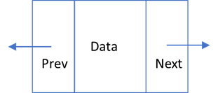
15.4 A Doubly Linked List Implementation with List Interface
Definition of Doubly Linked List:
a LinkedList is linked in both directions—forward and backward
each node contains not only a data part and a pointer to the next node (next) but also a pointer to the previous node (prev)

Slide 15
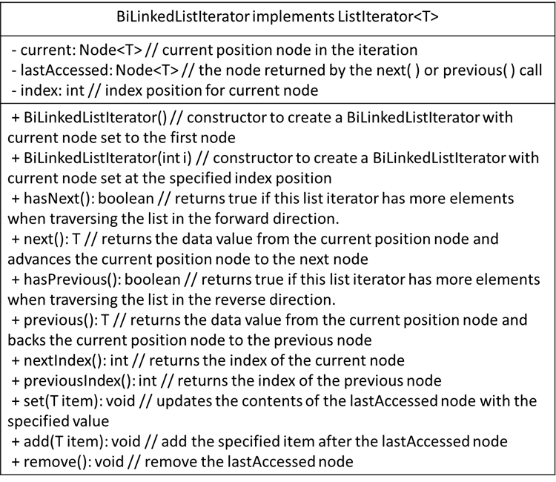
15.4 A Doubly Linked List Implementation with List Interface
Definition of BiLinkedListIterator

Slide 16
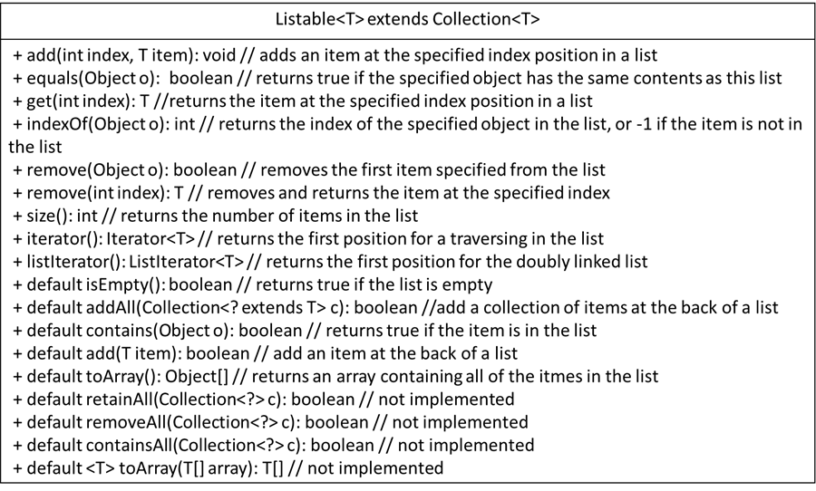
15.4 A Doubly Linked List Implementation with List Interface
Definition of Listable Interface

Slide 17
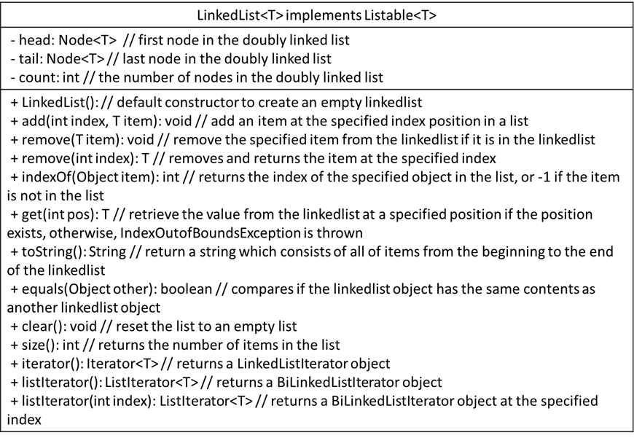
15.4 A Doubly Linked List Implementation with List Interface
Implementation of Doubly Linked List

Slide 18
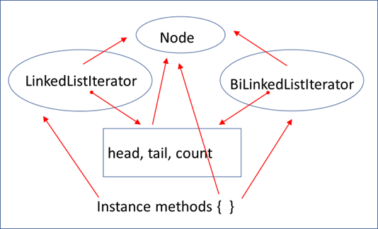
15.4 A Doubly Linked List Implementation with List Interface
Figure 5.20 Doubly linked list class components

Slide 19
15.5 Java Collections: LinkedList Usage
defined as a generic class in the package java.util.LinkedList<E>
implements both the java.util.List<E> interface and the java.util.Deque<E> interface
The List<E> interface provides methods to insert, remove, retrieve, and search items anywhere in a collection
The Deque<E> interface provides methods to insert, remove, and retrieve items at both ends of a collection
the LinkedList class can be used to create objects as a linked list ADT, a queue ADT, or a deque ADT.

